Slide 1

DIGITAL RESUME
Non-Syllabus Project Presentation
Submitted in partial fulfillment for the degree of
Bachelor of Technology
In
Department of Computer Engeeniring
To
by
By
Ravindra Singh Shekhawat
Reg. No.- 2021PUSCEBCEX10576
Harshit Sharma
Reg. No.- 2021PUSCEBCEX10505
Narendra Sharma
Reg.No.- 2021PUSCEBCEX10521
Meenakshi Sharma
Reg.No.- 2021PUSCEBCEX10626
Reenakshi Chandrawat
Reg.No.-2021PUSCEBCEX10655
Under the Supervision of
Shashikant Rathore
Assistant Professor,
Department of Computer Engeeniring
Poornima University, Jaipur

Slide 2
TABLE 0F C0NTENT
What is web development ?
Why web development is important?
Types of Web development
Project

Slide 3
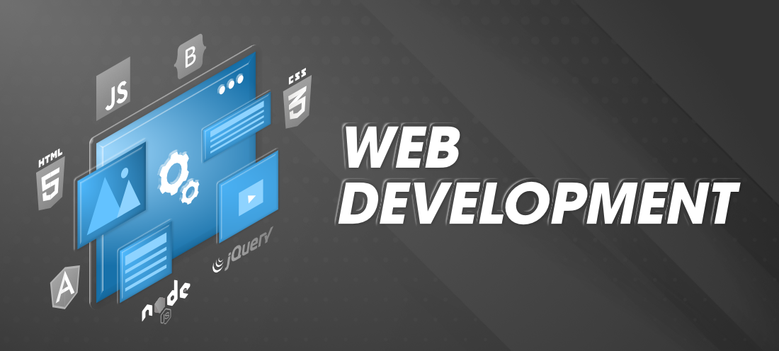
Web development refers to the building, creating, and maintaining of websites. It includes aspects such as web design, web publishing, web programming, and database management.

Slide 4
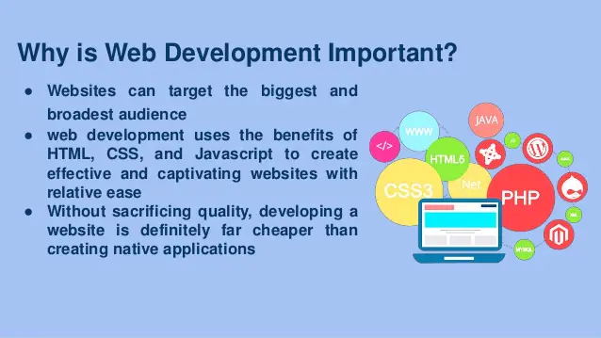

Slide 5
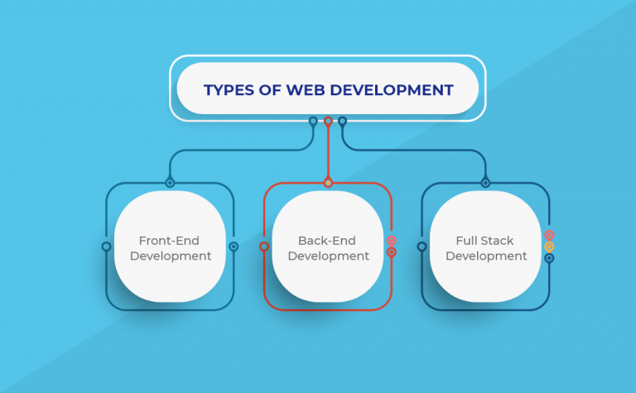

Slide 6
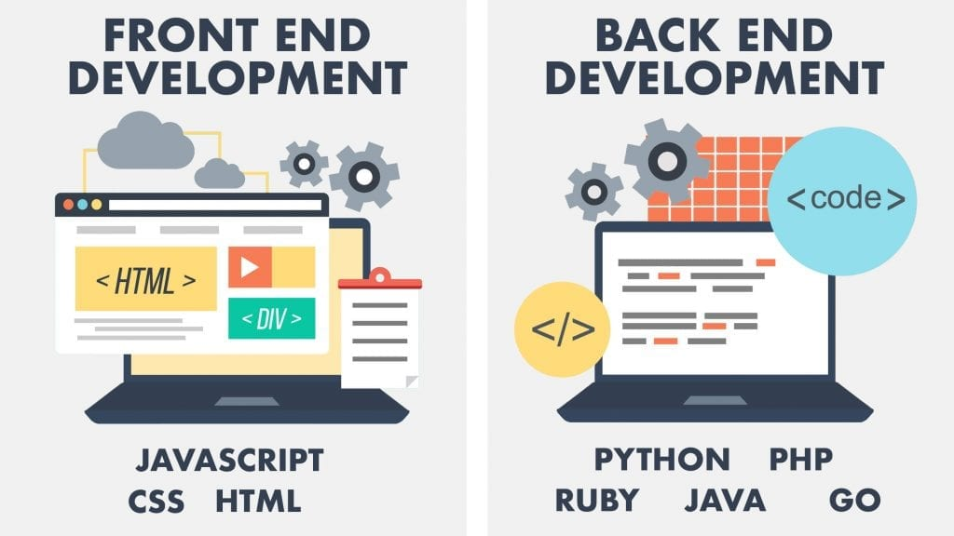

Slide 7
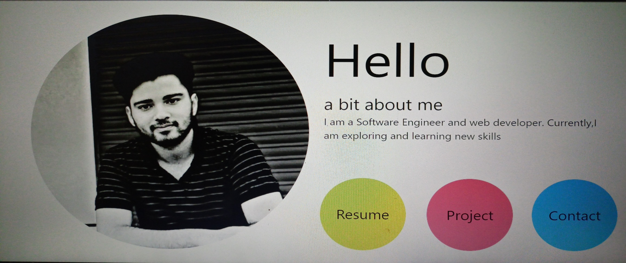

PROJECT NAME
Digital Resume

Slide 8
Project objective
I have made a project named “Digital Resume” . As per its name it will manage all my records and data. In this project we have a main menu, In this menu we have 3 options Resume, Project and last one contact. From the resume section you can download my Resume,
In project section you can see my projects and in contact section you get all the details about my social media ids.

Slide 9

Project technology

Slide 10
Project Modules
What is HTML ? why we use it ?
What is CSS ? why we use it ?
What is Java script ? why we use it ?

Slide 11
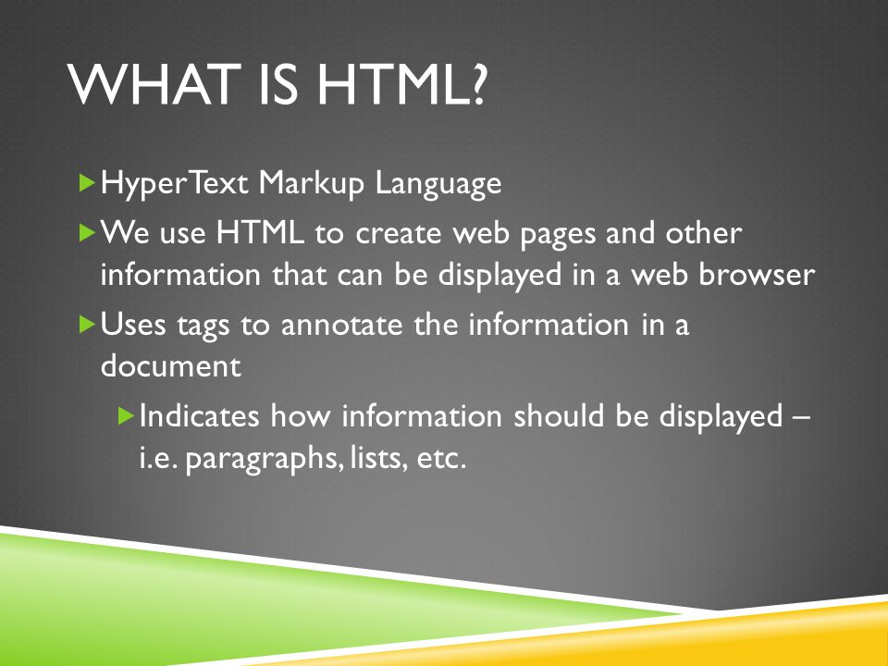

Slide 12
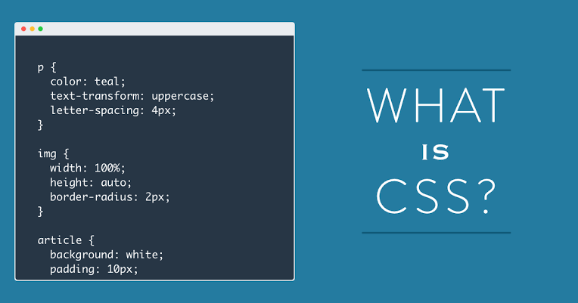

Slide 13
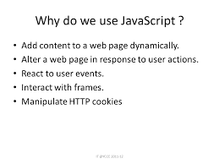

Slide 14
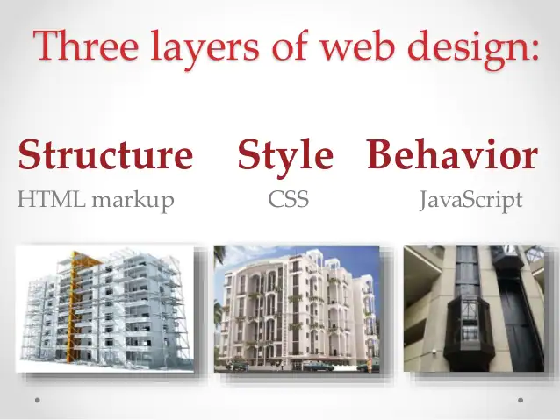

Slide 15
Project learning outcomes
From this project, I have learned many things such as how to make basic website, how to use HTML,CSS,JAVASCRIPT & how all of these works behind a web page

Slide 16


